Slide 1
TOPIC: Index Laws EQ: What is the relationship between the squared number and finding the square root?

Slide 2
Tasks
24
7
30
Topic
Essential Question
Questions
Notes
Summary
1
2

Slide 3
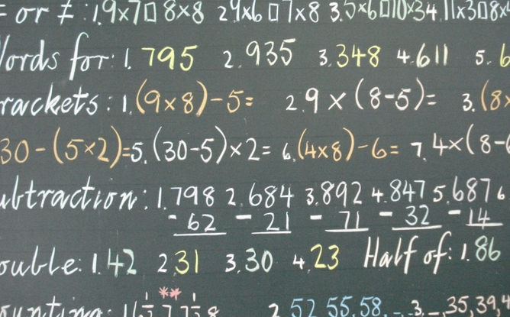
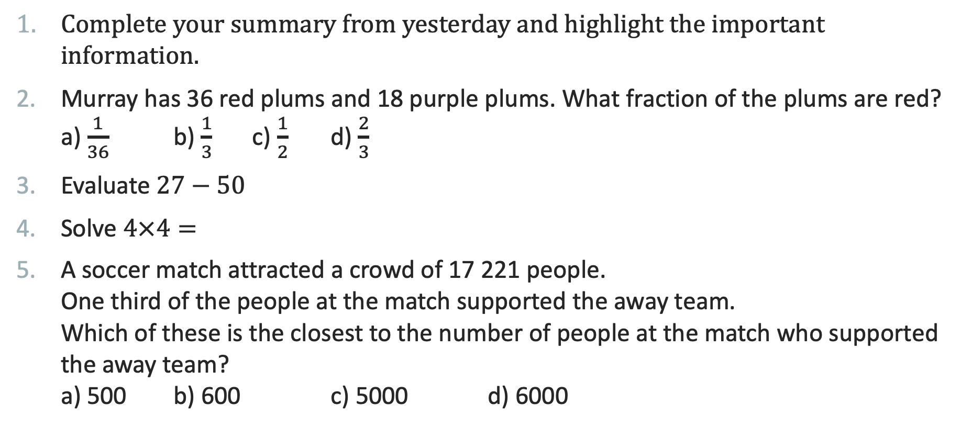
Five Questions (LHS)
Topic: Order of Operations EQ: What is the relationship between the square number and finding the square root?
Date: XX/XX/2021
Complete your summary from yesterday and highlight the important information.
Murray has 36 red plums and 18 purple plums. What fraction of the plums are red? a) $\frac{1}{36}$ b) $\frac{1}{3}$ c) $\frac{1}{2}$ d) $\frac{2}{3}$
Evaluate $27−50$
Solve $4×4=$
A soccer match attracted a crowd of 17 221 people. One third of the people at the match supported the away team. Which of these is the closest to the number of people at the match who supported the away team? a) 500 b) 600 c) 5000 d) 6000
This Photo by Unknown Author is licensed uder CC BY-ND
Notes:
Answers
43
$\frac{2}{3}$
-23
16
D) 6000

Slide 4

Starter activity
Draw a square on the grid with and area of 9 squares.
What is the side length of this square?
Draw a square on the grid with and area of 25 squares.
What is the side length of this square?
This Photo by Unknown Author is licensed under CC BY-SA-NC
Notes:
You will need grid paper for this lesson.

Slide 5
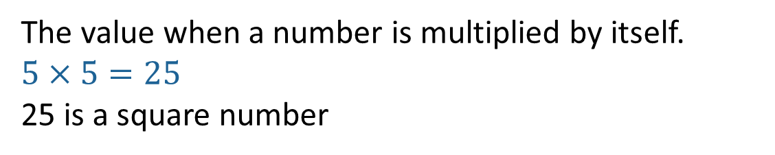

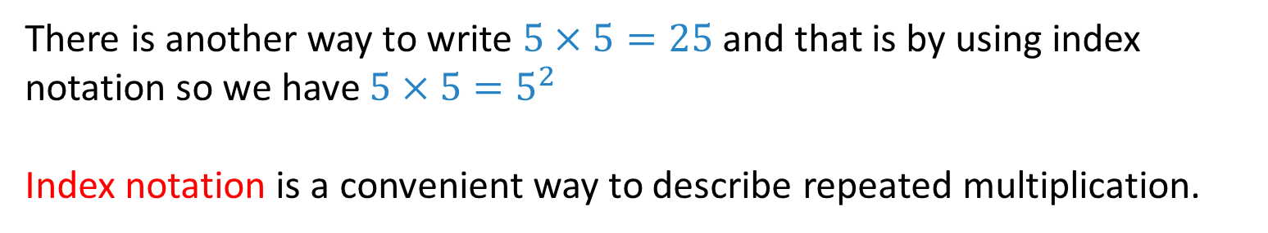
24
7
30
Topic: Order of Operations
Date: XX/XX/2021
EQ: What is the relationship between a square number and finding the square root?
What is a square number?
The value when a number is multiplied by itself.
$5×5=25$
25 is a square number
What is index notation?
There is another way to write $5×5=25$ and that is by using index notation so we have $5×5=5^{2}$
Index notation is a convenient way to describe repeated multiplication.
Exponent or index
$$5^{2}$$
WICOR
Base

Slide 6


Task: Calculate the following (LHS)
$1^{2}=1×1=1$
$2^{2}$
$3^{2}$
$4^{2}$
$5^{2}$
$6^{2}$
$7^{2}$
$8^{2}$
$9^{2}$
${10}^{2}$
${11}^{2}$
${12}^{2}$

Slide 7
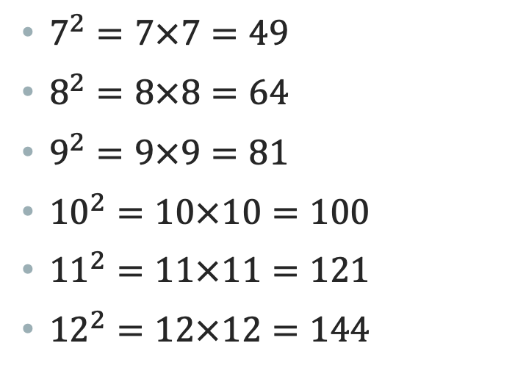
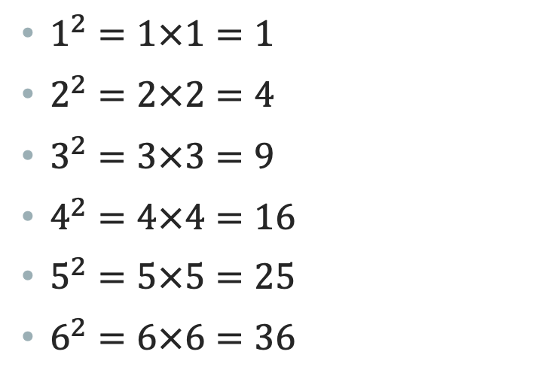
Task: Calculate the following (ANS)
$1^{2}=1×1=1$
$2^{2}=2×2=4$
$3^{2}=3×3=9$
$4^{2}=4×4=16$
$5^{2}=5×5=25$
$6^{2}=6×6=36$
$7^{2}=7×7=49$
$8^{2}=8×8=64$
$9^{2}=9×9=81$
${10}^{2}=10×10=100$
${11}^{2}=11×11=121$
${12}^{2}=12×12=144$

Slide 8
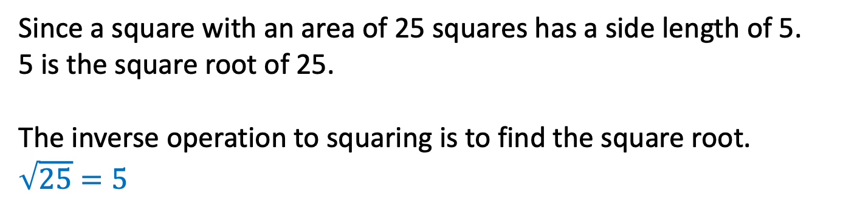
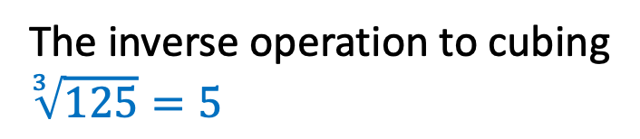
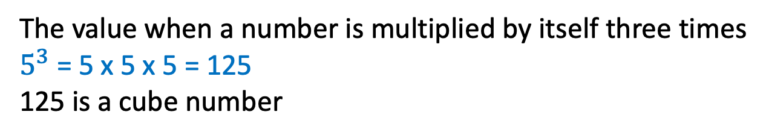
24
7
30
Topic: Order of Operations
Date: XX/XX/2021
EQ: What is the relationship between a square number and finding the square root?
What the square root?
Since a square with an area of 25 squares has a side length of 5.
5 is the square root of 25.
The inverse operation to squaring is to find the square root.
$$\sqrt{25}=5$$
What is a cube number?
The value when a number is multiplied by itself three times
$5^{3}$ = 5 x 5 x 5 = 125
125 is a cube number
What the cube root?
The inverse operation to cubing
$$\sqrt[3]{125}=5$$

Slide 9

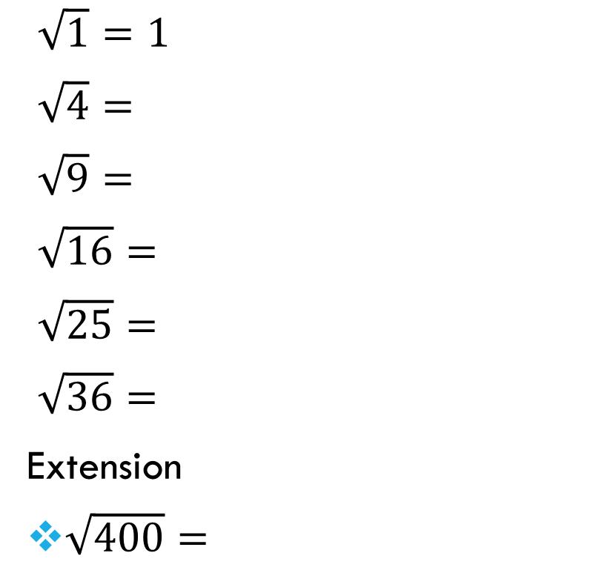
Task: Calculate the following (LHS)
$\sqrt{1}=1$
$\sqrt{4}=$
$\sqrt{9}=$
$\sqrt{16}=$
$\sqrt{25}=$
$\sqrt{36}=$
Extension
$\sqrt{400}=$
$\sqrt{49}=$
$\sqrt{64}=$
$\sqrt{81}=$
$\sqrt{100}=$
$\sqrt{121}=$
$\sqrt{144}=$
$\sqrt{2500}=$

Slide 10

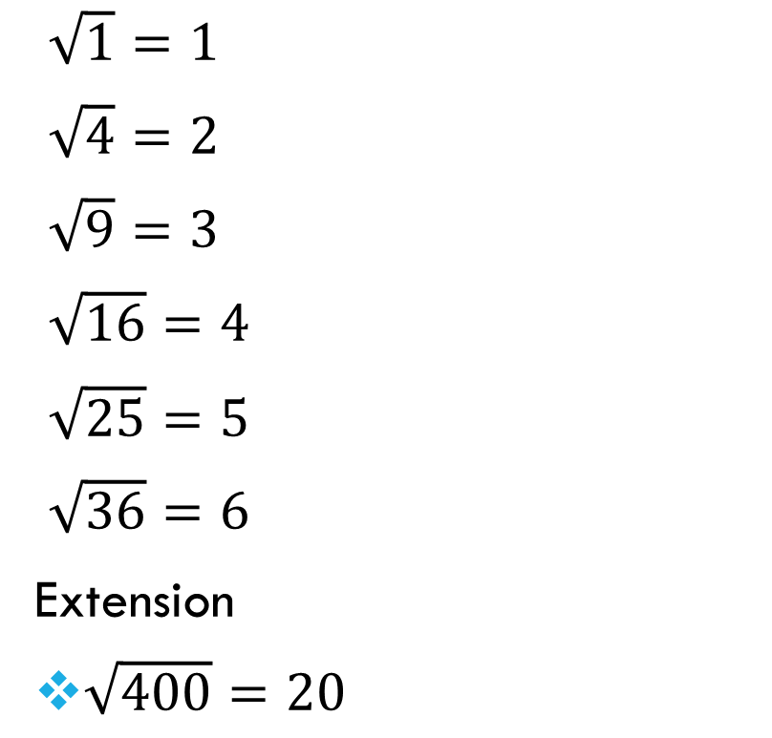
Task: Calculate the following (ANS)
$\sqrt{1}=1$
$\sqrt{4}=2$
$\sqrt{9}=3$
$\sqrt{16}=4$
$\sqrt{25}=5$
$\sqrt{36}=6$
Extension
$\sqrt{400}=20$
$\sqrt{49}=7$
$\sqrt{64}=8$
$\sqrt{81}=9$
$\sqrt{100}=10$
$\sqrt{121}=11$
$\sqrt{144}=12$
$\sqrt{2500}=50$

Slide 11
TASK
Worksheet on roots and square roots.
Further tasks –
Dwyer Book, Page 2

Slide 12
Notes Review
24, 7 ,30
Date
Title
Essential question
Notes complete
Notes complete with colour and diagrams
Questions completed
Contents page filed in
Formula page filled in

